Slide 1
Circular Data

Slide 2
What is Circular Statistics?
The term circular statistics refers to a particular branch of the discipline of statistics that deals with data that can be represented as points on the circumference of the unit circle.
Data of this type are themselves referred to as being circular, a term used to distinguish them from the usual linear data that we are more used to.

Slide 3
What is Circular Statistics?
More formally, we say that the support for circular data is the unit circle (as opposed to the real line which is the support for linear data).
Examples of circular data include directions measured using instruments such as a compass, protractor, weather vane, sextant or theodolite.

Slide 4
What is Circular Statistics?
It is usual to record such directions as angles expressed in degrees or radians measured either clockwise or counterclockwise from some origin, referred to as the zero direction.
The requirements to specify the position of the origin and the direction taken to be positive do not arise for data on the real line; the origin is 0, values to the left of 0 are negative and those to the right are positive.

Slide 5
What is Circular Statistics?
So, on the real line, a value of 360 is relatively close to a value of 355 but relatively far from the origin.
For circular data, each measurement should define a point on the circumference of the unit circle, just as each value of a linear variable defines a point on the real line.
Notes:
As the absolute value of a linear variable increases we move further away from the origin.

Slide 6
What is Circular Statistics?
While an angle of 355֩ºcorresponds to a point on the circumference of the unit circle that is close to that corresponding to 360º, the angles 0º and 360º define essentially the same point.
It is this periodic nature of circular data that forces us to abandon standard statistical techniques designed for linear data in favor of those which respect the periodicity of circular data.
Notes:
The situation is very different for circular variables

Slide 7
What is Circular Statistics?
As an illustration of what can go wrong if we treat circular data as being linear, suppose we measured the directions of flight, clockwise from north, of homing pigeons released at a certain location.
If the angles measured for four birds were 10º, 18º, 340º and 352º then commonsense tells us that the birds generally fly approximately northwards

Slide 8
What is Circular Statistics?
However, the arithmetic mean of these angles is 180º - directly due south!
Measured directions recorded as angles constitute one type of circular data, not all circular data are necessarily initially measured or recorded as angles.
The key to understanding this point is the periodicity of circular data.

Slide 9
What is Circular Statistics?
Consider, for example, the time of day measured on a 24-hour clock.
The times 0:00 and 24:00 both correspond to midnight, and 1:00 and 23:00 both define times one hour “away from” midnight.
Each time corresponds to a position of the hour hand on a 24-hour clock, and each such position can be converted to an angle measured in degrees by multiplying the time in hours by 360/24.

Slide 10
What is Circular Statistics?
Further examples include the bonding angles of molecules, the direction of the wind measured at a wind farm at 12:00 each day, the times during the day of cyber-attacks at an intelligence center, and the incidence throughout the year of measles, lightning strikes on a major city, or solar flares.

Slide 11
What is Circular Statistics?
The reference, or ‘zero’, point, such as 1 January, midnight or north, is an arbitrary human construct that generally does not relate well to the underlying drivers of the system under study.
We might, by convention, label 1 January as day one and 31 December as day 365, but in terms of dengue incidence in a large metropolitan area, or the prevailing wind direction at a weather station, we might expect the values recorded on these days to show strong commonality.

Slide 12
What is Circular Statistics?
Near-global agreement on the timing of New Year is a relatively recent construct reflecting the pervading influence of Western culture; there is no astronomical reason why it should be so.

Slide 13
What is Circular Statistics?
A circular observation can be regarded as a point on a circle of unit. radius, or a unit vector (i.e. a direction) in the plane.
Once an initial direction and an orientation of the circle have been chosen, each circular observation can be specified by the angle from the initial direction to the point on the circle corresponding to the observation.

Slide 14
Related Types
Axial data
  data for which the angles θ and θ + π (radians) are indistinguishable, can be represented as points on the semi-circumference of a semicircle of unit radius
Bivariate
  Toroidal
  Cylindrical
  Spherical

Slide 15
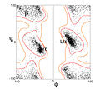
Example: Toroidal data

Slide 16
Graphical Representation of Circular Data

Slide 17
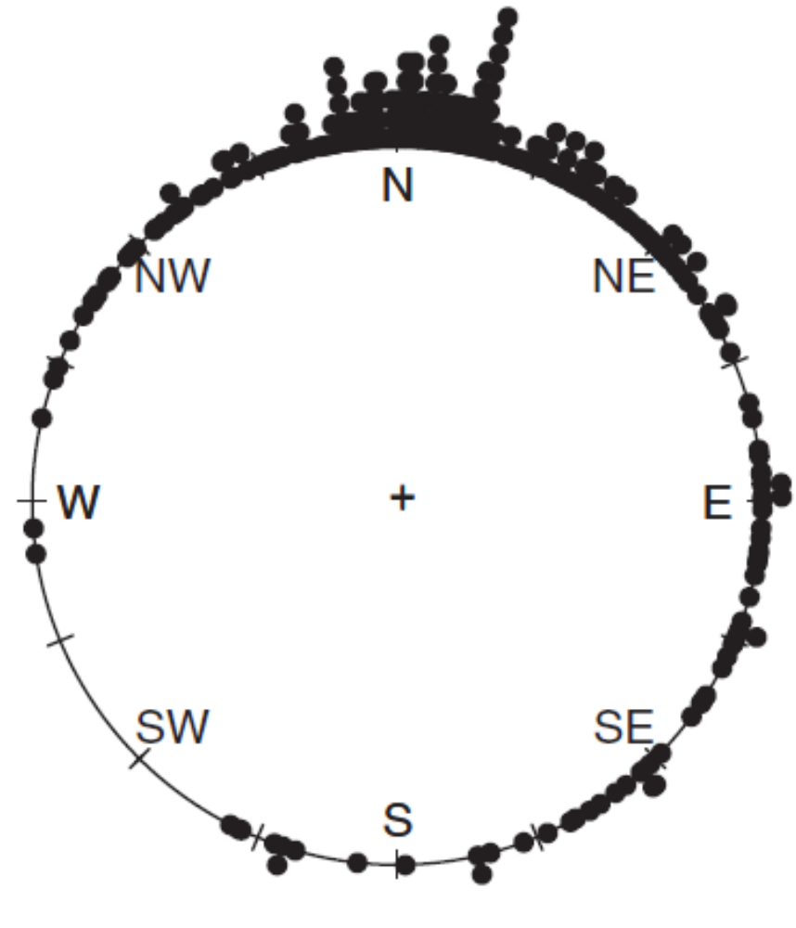
Raw Circular Data Plots
raw circular data plot of 310 wind directions, measured in radians
clockwise from north, recorded at a meteorological station in the Italian Alps

Slide 18
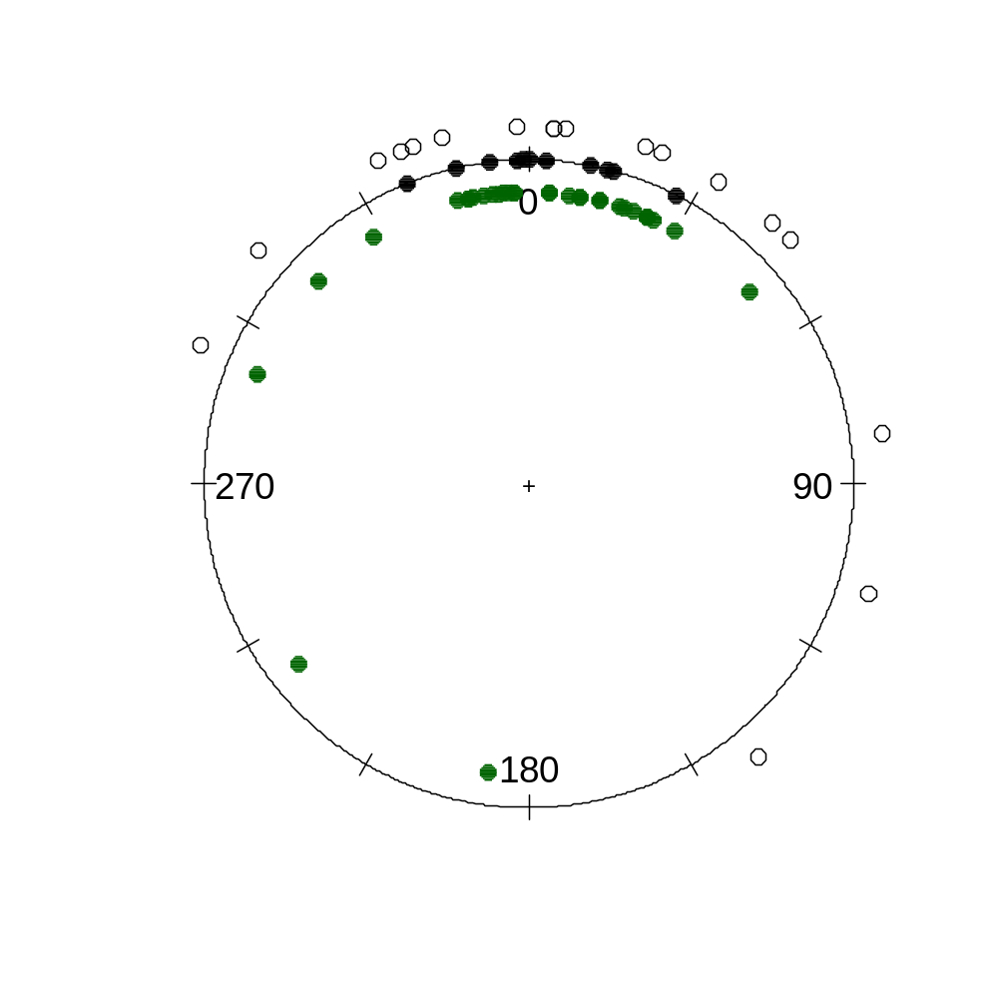
Raw Circular Data Plots
Raw circular data plot of the walking directions of long-legged desert ants under three different
experimental conditions indicated using different plotting symbols

Slide 19
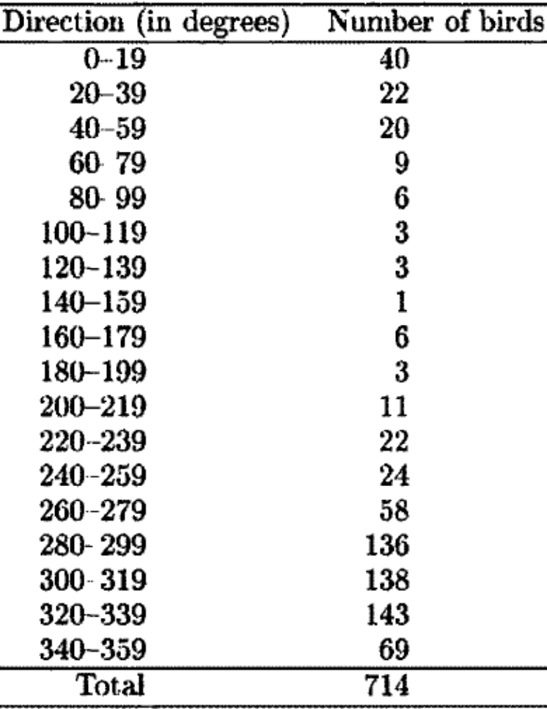
Grouped Data
Vanishing angles of 714 British mallards. Directions are measured clockwise from north.

Slide 20
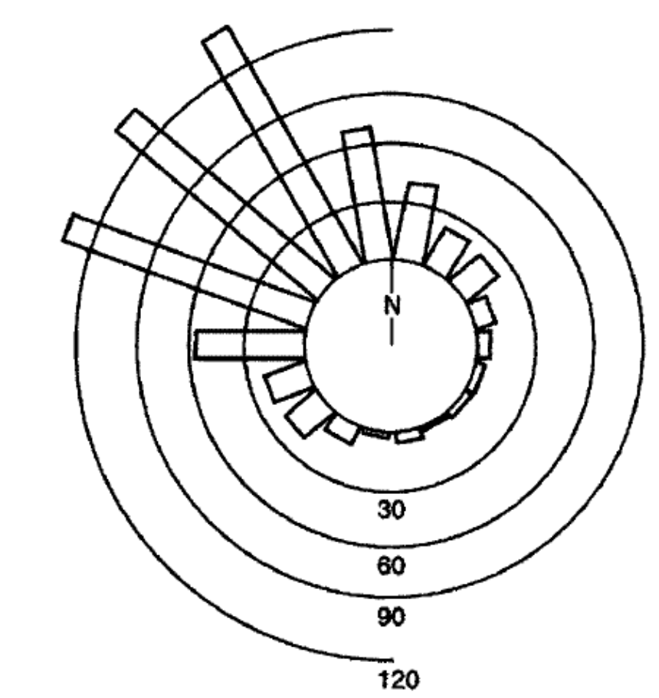
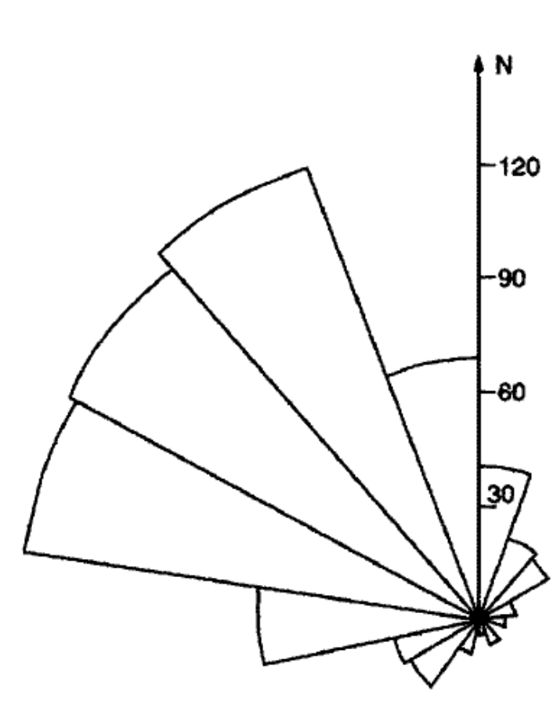
Grouped Data
Circular Histogram
Rose Diagram

Slide 21
Wrapping and Projecting
Circular data fall into two groups.
Data in the first group are obtained by taking data on the line and wrapping the line round the circle, e.g. reducing times to times of day.
Such data are obtained typically from measurements with a clock

Slide 22
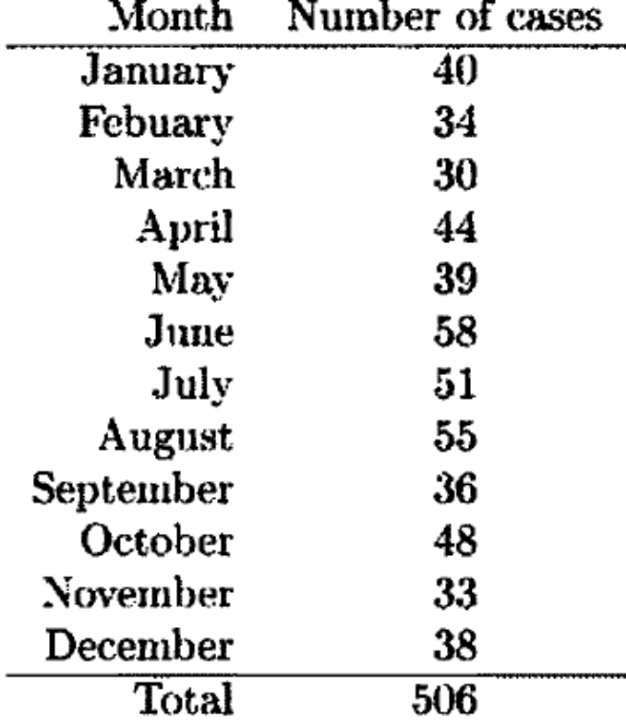
Wrapping and Projecting
Month of onset of cases of lymphatic leukaemia in the UK, 1946-1960

Slide 23
Wrapping and Projecting
Data in the second group are obtained by taking data in the plane and projecting the plane radially onto the unit circle.
An example of these wind directions.
Such data are obtained typically from measurements with a compass

Slide 24
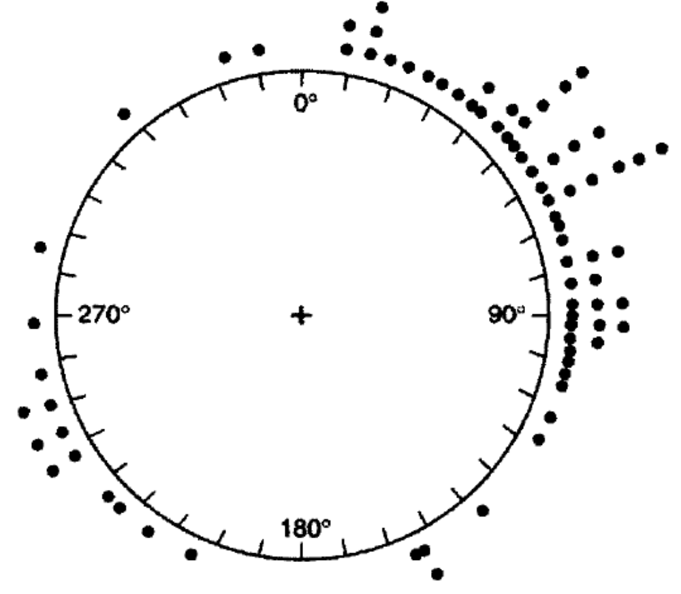
Wrapping and Projecting
Orientations of 76 turtles after laying eggs

Slide 25
Circular Summary Statistics

Slide 26
Preliminaries and Notation
The most natural way of representing a circular observation graphically is as a point on a circle; the circle representing, for example, the face of a compass or a 12 or 24 hour clock, or a means with which to identify the time of the year.
The radius of the circle, r > 0, is immaterial, and the choice r = 1 simplifies things mathematically.

Slide 27
Preliminaries and Notation
For this choice, each observation defines a unit vector, x, directed from the center of the unit circle to the observation on the unit circle.
Equivalently, once an origin has been chosen (e.g. north, or the one used in mathematics corresponding to the positive horizontal axis) together with an orientation (e.g. clockwise from north or counterclockwise from the mathematical origin), a circular observation can be represented by the angle, θ, subtended by the arc around the unit circle, in the chosen orientation, from the origin to the observation.

Slide 28
Preliminaries and Notation
Negative values of θ correspond to angles measured in the opposite direction to the chosen orientation.
Directions in the plane can be regarded as unit vectors x, or equivalently as points on the unit circle (i.e. the circle of unit radius centered at the origin).

Slide 29
Preliminaries and Notation
Another useful way of representing directions - as angles.
  Choose an initial direction and an orientation for the unit circle. (This is equivalent to choosing an orthogonal coordinate system on the plane.)
Then each point x on the circle can be represented by an angle θ, i.e.
x = (cos θ, sin θ)^{T}

Slide 30
MEASURES OF LOCATION

Slide 31
Mean Direction
Suppose that we are given unit vectors x₁,..., x_{n} with corresponding angles θ_{i} , i = 1,..., n.
The mean direction θ_{mean} of θ₁,..., θ_{n}, is the direction of the resultant x₁ +...+ x_{n}, of x₁,..., x_{n}.
It is also the direction of the center of mass of x₁,..., x_{n} .

Slide 32
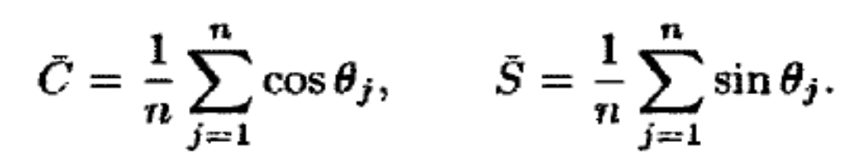
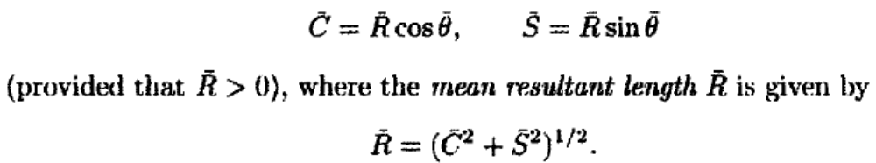
Mean Direction
Since the Cartesian coordinates of x_{j} are (cos θ_{j}, sin θ_{j}) for j = 1,..., n, the Cartesian coordinates of the center of mass are
Therefore θ_{mean} is the solution of the equations

Slide 33
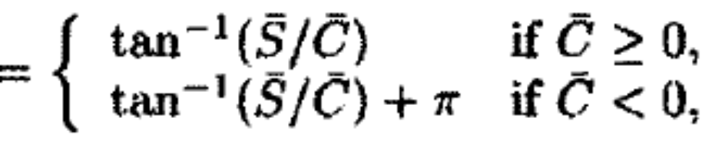
Mean Direction
Note that θ_{mean} is not defined when Ṝ = 0.
When Ṝ > 0, θ_{mean} is given explicitly by
θ_{mean}
where the inverse tangent function 'tan⁻¹ ' (or 'arctan') takes values in [-π/2, π /2].

Slide 34
Mean Direction
An important property of the mean direction is that it is equivariant under rotation, i.e., the mean direction of θ₁ - α,..., θ_{n} – α is θ_{mean} – α.
The importance of such equivariance on the circle is that data analysts using different coordinate system will agree on where the sample mean is, even though they may use different nubers to describe its position.

Slide 35
Median Direction
A sample median direction θ_{median} of angles θ₁,..., θ_{n} is any angle ϕ such that
  (i) half of the data points lie in the arc [ϕ, ϕ + π), and
  (ii) the majority of the data points are nearer to ϕ than to ϕ + π .
When the sample size n is odd, the sample median is one of the data points.
When n is even, it is convenient to take the sample median as the midpoint of two appropriate adjacent data points.

Slide 36
Next Topic:
Spatial Data

